Slide 1
UNL Chemistry Safety Training: Work or research not involving any hazardous materials
Online at: http://www.chem.unl.edu/safety/
Martha Morton / Jiantao Guo
Safety co-Chairs
mmorton4@unl.edu / jguo4@unl.edu

Slide 2
Outline:
Required training
Basic principles/risk assessment
Alarms and evacuation
Injuries/first aid/medical treatment
Power outages
PPE and Safety Equipment
Fires: What should you do?
Chemical spills? What should you do?
Electrical hazards
Personal Safety/Crime
Safety Committee (contacts)
Links and Resources
Assessment.

Slide 3
Required training
A) Complete EHS on-line training:
http://ehs.unl.edu/onlinetraining/).
  #1: Core - Injury and Illness Prevention Plan (IIPP)
  #2: Core - Emergency Preparedness Training.
  Fire Extinguisher Training (FET)
B) Complete Departmental assessment (this process)
  Complete and pass written training assessment.
If you will have contact with chemicals/hazardous materials, there is more to do and this is not the appropriate training.

Slide 4
Overarching principles: a warm-up
Know the hazards (and warnings/alarms) related to work in Hamilton.
Be prepared for an emergency:
  What should I do in the event of a fire? (or flood, or chemical spill, or power outage, or presence of intruder).
  Where do I go during a tornado?
  A student has a serious chemical exposure? What should I do?
  Where is the nearest (exit/eyewash/fire extinguisher/shower)?
  My coworker has a very bad laceration? what do I do?
Before you do anything, take a second to evaluate hazards:
  Why did this person collapse? Can I help them without getting electrocuted or poisoned?

Slide 5
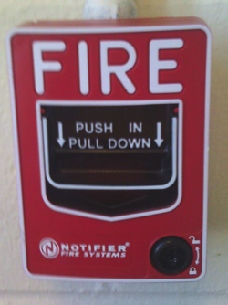

Summoning emergency responders: Fire alarm
North
Hamilton Hall
Fire (unless very minor)
Major chemical spill or toxic leak.
Only easy way to evacuate building
Pull down alarm.
Leave building
Call 472-2222 from outside to give more details

Slide 6
Fire alarm: what should you do?
Exit immediately via stairs. A fire can quickly trap you.
  Close office and lab doors behind you.
  Inform a UNL police officer or a member of the safety committee of any potential problems resulting from evacuation.
Gather on south side (Sheldon museum parking lot).
  If your lab is missing someone who was near the fire/emergency, notify emergency officials.
DO NOT reenter the building until the “all clear” signal is given.

Slide 7
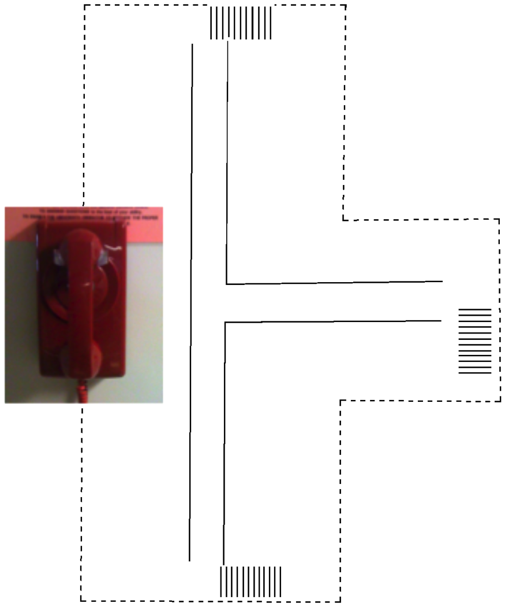
Summoning emergency responders: Red phone or 402-472-2222)
Chemical spill, injury, crime, or a threatening person (anytime you feel danger or see danger to others.
Pick up phone-wait for operator.
Tell him/her:
the type of emergency
the location (Hamilton Hall, what floor, what room)
your name
any other important facts.
  Stay on the line unless you are in danger.

Slide 8
TORNADO alarm
  Use north or east stairs to get to floors 2,3,4 (stay in labs or alcoves in north end of corridor) or use elevator to get to basement.
    Give up space on elevator to anyone who would have trouble using the stairs.
  STAY AWAY from windows. A tornado is likely to shatter windows and create flying glass shards
  DO NOT go outside.
  Even if the alarm does not sound, seek shelter if you hear the city alarm or if authorities broadcast a tornado warning.
    Tornado alarms are tested at 10:15 am one Wed each month in spring and summer - when the weather is good. If the tornado alarm sounds at exactly 10:15 on a Wednesday, check your phone or computer to see if you need to evacuate.
    More information: http://emergency.unl.edu/procedure/tornado

Slide 9
Major Injuries:
Call 911 or 402-472-2222 or use Red phones.
Bleeding: Put on gloves and safety glasses. Apply pressure. Yell for help (so someone else can summon ambulance).
Chemical splashes:
  Arm or hand: Wash in a sink with lots of water.
  In eyes (wear goggles!)-use eyewash with lots of water.
  Remove contaminated clothing! Get under the shower!
  Once you have removed the chemical, seek medical treatment. Ask others to bring an MSDS for the chemical.
  Nearest Emergency Room: Bryan LGH Medical Center-West, 16th & South Streets) 402-475-1011

Slide 10
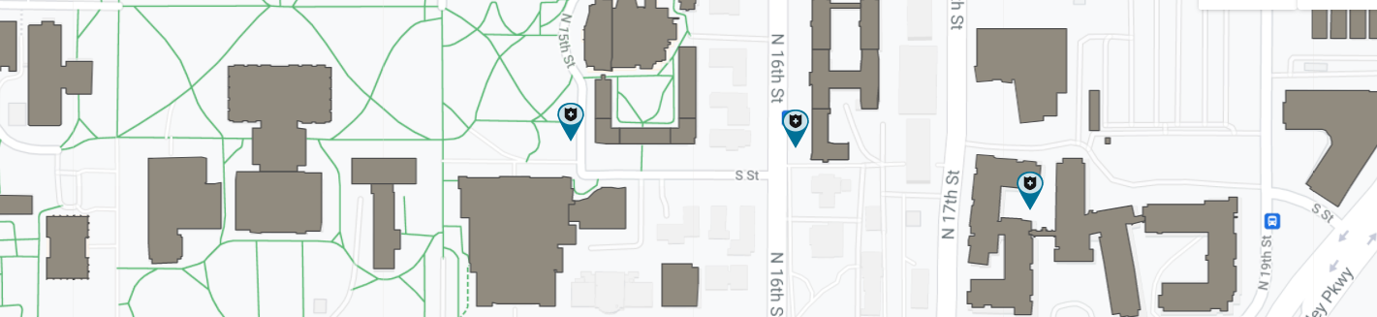
First Aid and minor injuries
Every lab and every group of offices should have a first aid kit
  Students with minor injuries may may go to the Univ. Health Ctr (550 S. 19th Street): 402-472-5000. Mon-Fri, 8-5.
  Faculty/staff (and students after hours): hospital or clinics
  Bryan LGH Medical Center-West, 16th & South Streets) 402-475-1011
  LincCare, 5000 N 26th St (402-435-2060)
  Heartland Urgent Care, 965 S. 27th Street, Suite D, 402-477-3505
  Or other clinics or your private physician.
After hours: A nurse can be reached by phone:
402-472-5000:
  More info about injuries:
  http://ehs.unl.edu/sop/s-injury.pdf
  http://www.chem.unl.edu/safety/UNL_Chemistry_Injury_Procedures2021.pdf

Slide 11
Power outages
Daytime: call business manager (Dodie Eveleth, 2-5312);
After hours: 2-2222 (402-472-2222)
If a power outage lasts more than a few minutes, because fumes will develop within the building when hoods are not on:
  Turn off equipment if there could be problems when power is restored.
  Close hood sashes.
  Lock all doors and leave the building.
  Do not reenter until power is restored.
Major chemical spills (more later)
Pull fire alarm. Use red phone or
402-472-2222 to give information about spill.
DO NOT remain in area of spill unless you are ABSOLUTELY SURE you are not in danger.
If you can safely remain near the spill, use chairs/tables/trash cans to block off area.

Slide 12
PPE, part 2: Gloves
Disposable nitrile gloves are often used for transient protection:
  Check the permeability of your gloves against the chemical: http://ehs.unl.edu/documents/chemical-safety
  Immediately replace damaged / contaminated gloves. Grasp the sleeve and pull it towards your fingertips, inside-out. Wash your hands before re-gloving.

Slide 13
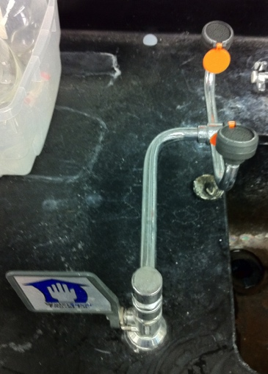
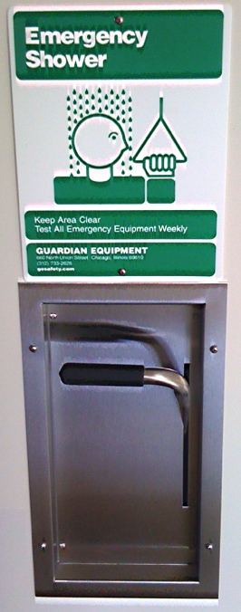
Showers and eyewashes
Showers
  Located just outside or just inside selected doorways
    Where is the nearest one?
  To operate, stand under the shower, and pull down the handle (overhead rings in some parts of building)
Eyewash fountains
  Where is the one closest to you?
    Push on the handle, flush eyes thoroughly (15 min!) Rinse out fountains weekly. Make sure they remain accessible.
•Help the injured person get to the eyewash or shower-don’t worry about the mess
•Yell for help
•Offer your lab coat if someone needs to remove their clothes.

Slide 14
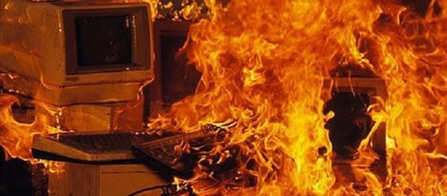
Fires: Fight or leave?
http://flavioontivero.weebly.com/uploads/4/5/3/2/45324599/484178135.jpg
You can fight a fire if:
  It is confined to a small area and you are not alone.
    You need someone as a back-up who can call for help.
  You are in no danger
    You know what is burning and you are either protected from fumes or you are sure there is no danger.
  You have a clear escape path.
    Labs, lab books, chemicals and equipment can be replaced-you cannot.
Do not attempt to fight a fire that is:
  Large or could quickly become large;
  Is making the air hard to breathe (smoke inhalation)
  May expose you to hazardous materials

Slide 15
Fire: Sounding the alarm
For anything more than a very small fire:
  alert your coworkers (yell!):
  close the doors to the area and leave;
  pull the the nearest fire alarm (near each stairwell)
  If you can’t safely get to an alarm on your floor, wait and call 402-472-2222 or 911 from outside.
Once you exit the building
  Call 402-472-2222 or 911 and give the operator more information about the location of the fire.
  When firefighters respond, identify yourself and offer to provide information about the location of the fire.

Slide 16
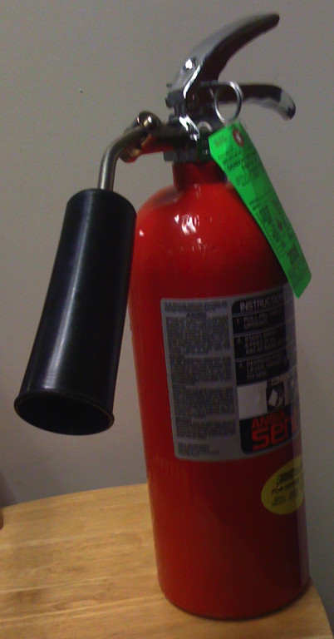
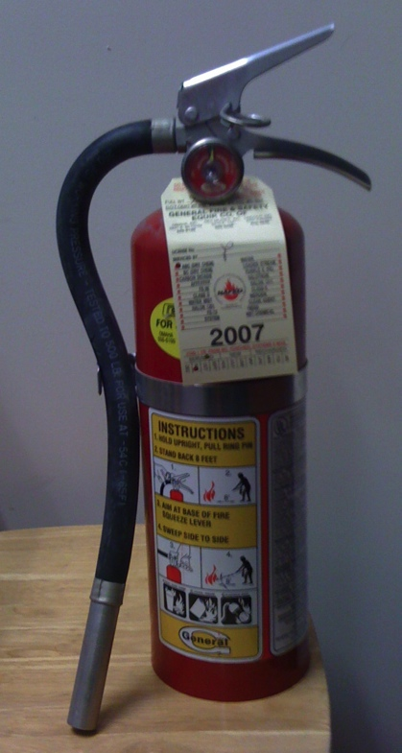
Fire Extinguishers in Hamilton
Dry powder aka
“dry chemical”
Carbon dioxide
  Distinguish by large cone or “horn” nozzle on CO₂.
  Found in most labs and in multiple locations in hallways.
  Choice will depend on nature of fire.
PIN
(release)
To use: (either type)- Acronym TOSS
1. T - Twist and break plastic retaining strap;
2. O - Pull out pin;
3. S - Squeeze handles together to operate
4. S - Sweep the base of fire with CO2 or dry powder

Slide 17
Dry chemical extinguishers: when to use
Carbon dioxide: excellent for fires near computer/electrical equipment; small solvent fires.
  Surprisingly poor for fires on paper, cardboard.
Dry powder: will quickly “knock down” most solvent and chemical fires and those where CO₂ would react with the burning material (e.g., sodium).* Never use on people.
  *Fires involving any significant quantity of reactive metals and metal hydrides require a special Class D extinguisher not covered here.
  After using a dry powder extinguisher, turn off computers and electrical equipment to minimized damage.

Slide 18
Chemical Spills: “Should I stay or should I go?”
  Tailor your response to the hazard and situation
You must know the material (and the hazards)
  Do you have appropriate PPE?
  Are you sure you will be safe (ventilation, etc.)?
  Do you have someone with you as back-up?
If a spill is large or dangerous, leave!
  402-472-2222, 911 or red phone from a safe distance.
You may attempt to deal with chemical spills if:
  You are in no danger, you are not alone and you have a path of retreat.
  You have appropriate PPE and a spill kit.
See: Preplanning for and Responding to Hazardous Chemical Spills
at http://ehs.unl.edu/sop

Slide 19
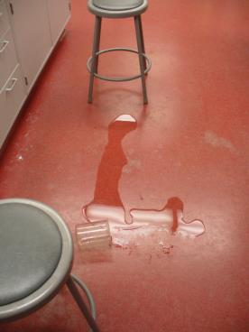
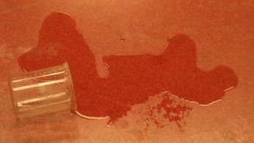
Chemical spills: what should you do?
For any spill, first priority is to alert others (fire alarm, red phone, 402-472-2222)
  Close off the area if this is safe for you.
  Use chairs/stools to close off part of a lab or corridor for a smaller spill
  Use the fire alarm to clear the building in case of a major spill.

Slide 20
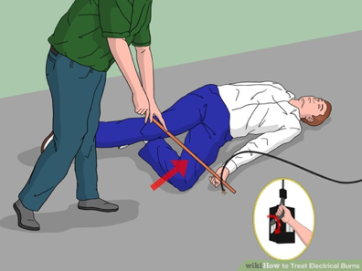

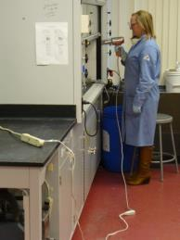
Electrical hazards
Always look first
  Do not work on electrical equipment or touch an unconscious person unless you are sure there is no source of electricity.
Avoid spark sources near solvents
Electrical cords/ cables
  Should not obstruct work or aisles.
  Extension (“drop”) cords only for short-term use; power strips can be used long-term but not on high amperage devices.
  Do not “daisy-chain” cords or power strips.
  Discard and replace damaged cords.
Consult Chemistry Electronics shop with any concerns.
science.howstuffworks.com
Localelectricalne.com

Slide 21
Personal Safety and Crime.
UNL is fairly safe (see http://police.unl.edu/statistics) -let’s keep it that way.
  Don’t prop open outside doors or admit strangers.
  Be careful when you are alone. Use a “buddy” system.
  Lock valuables in desk drawers when leaving offices.
  See something suspicious? 402-472-2222
    http://police.unl.edu/reporting-troubling-or-threatening-behavior)
  If you feel you are in danger, remember:
    Run - If there is a clear and safe escape route
    Hide - If there is no escape and you can get to a secure location to hide
    Fight - If your only option is to defend yourself, fight as if your life depended upon it.
    https://emergency.unl.edu/procedure/shooting-incident

Slide 22
Safety Committee (2021 - 2022)
Jiantao Guo, co-Chair
  634A HaH; jguo4@unl.edu
  2-3525 (office)
Martha Morton, co-Chair
  834 Hamilton, 2-6255; mmorton4@unl.edu (860)428-2044 (cell)
Members
  Prof. Yinsheng Guo ( HaH, 2-5172)
  Ms. Dodie Eveleth (Building manager, 545 HaH, 2-5312)
  Prof. Rick Hartung (Resource Room, 2-2737)
  Ms. Jessica Periago (227 B HaH, 2-3812)
  Prof. Alex Sinitskii (604C HaH, 2-3543)
  Prof. Katie Eichhorn (723 HaH, 2-2426)
  Dr. Mark Helle (Chemistry Stockroom)

Slide 23
Links and Resources
UNL Chemistry: http://www.chem.unl.edu/safety/
  UNL Environmental Health and Safety: http://ehs.unl.edu/ (402-472-4925)
  Online training: http://ehs.unl.edu/onlinetraining
  Safe Operating Procedures (many!)
  As a general resource: Questions about chemical safety, reaction hazard assessment, labeling, disposal-almost anything?

Slide 24
Things to do TODAY
Put the UNL Emergency contact on your phone:
  402-472-2222
Sign up for UNL Emergency Alerts:http://unlalert.unl.edu
Thank you for attending. Contact me if you have any questions or concerns:
  Prof. Martha Morton
  (402)-472-6255
  mmorton4@unl.edu

