Slide 1
UNL Chemistry Safety Training
Online at: http://www.chem.unl.edu/safety/
Summer 2019
Presenter: Martha Morton
Safety Committee
mmorton4@unl.edu

Slide 2
Outline:
Required training
Overarching principles
Risk Assessment
Required practices
Alarms and evacuation
Safety Equipment: Eyewashes and Showers
First Aid /Health Center
Fire Safety
Personal protective equip.
Fume hoods
Safety Data Sheets, etc
Chemical handling/storage
Chemical Spills
Radiation Safety
Biosafety
Floods and Flood Prevention
Electrical Hazards
Personal Safety/Crime
Links and Resources
Cryogens
Discussion of common lab accidents/incidents.
Assessments
  Training
  (Brief) homework on safety equipment

Slide 3
Required training
Research or work could hazardous materials:
A) Complete EHS on-line training (or full-day safety workshops)
http://ehs.unl.edu/onlinetraining/
  #1: Core - Injury and Illness Prevention Plan (IIPP)
  #2: Core - Emergency Preparedness Training.
  #3: Chemical Safety Training;
  #4: Fire Extinguisher Training
  #5 Personal Protective Equipment (PPE).
B) Chemistry departmental assessment (this process)
ZERO contact with hazardous materials:
Core #1 and #2 (above) and Departmental training/assessment
  Members of Li, Zeng, or Moon groups; some staff members.
  Not an option for any student who might be a teaching assistant.
  Confirm with Safety Chair if not sure.

Slide 4
Overarching principles: a warm-up
Always follow standard practices for clothing and protective equipment. What are these?
Before you do anything, evaluate potential hazards – and then plan your actions.
  What are some possible hazards with your research?
  How can you find the hazards associated with chemicals?
  Are any special hazards (electrical, laser, biosafety) present?
  Are any engineering controls needed ?
    What might these be?
What types of personal protective equipment are needed?
Be prepared for an emergency:
  Where is the nearest (exit/eyewash/fire extinguisher/shower)?
  What should I do in the event of a fire? flood? chemical spill?

Slide 5
What kinds of risk might you encounter?
Chemical (flammable, corrosive, health, reactivity)-next page
  Could include explosion
  What about byproducts of the reaction?
Pressure
  Gas cylinders
  Reaction pressure (related: release of toxic gases)
Fire (Smoke/chemical inhalation; burns)
Electrical (death; serious burns)
UV or Laser (eye damage)
Cut or laceration; crushing (loss of blood; loss of limb)
Slip/fall
In general, imagine what could possibly go wrong?
If you have any doubts, contact UNL EHS.

Slide 6
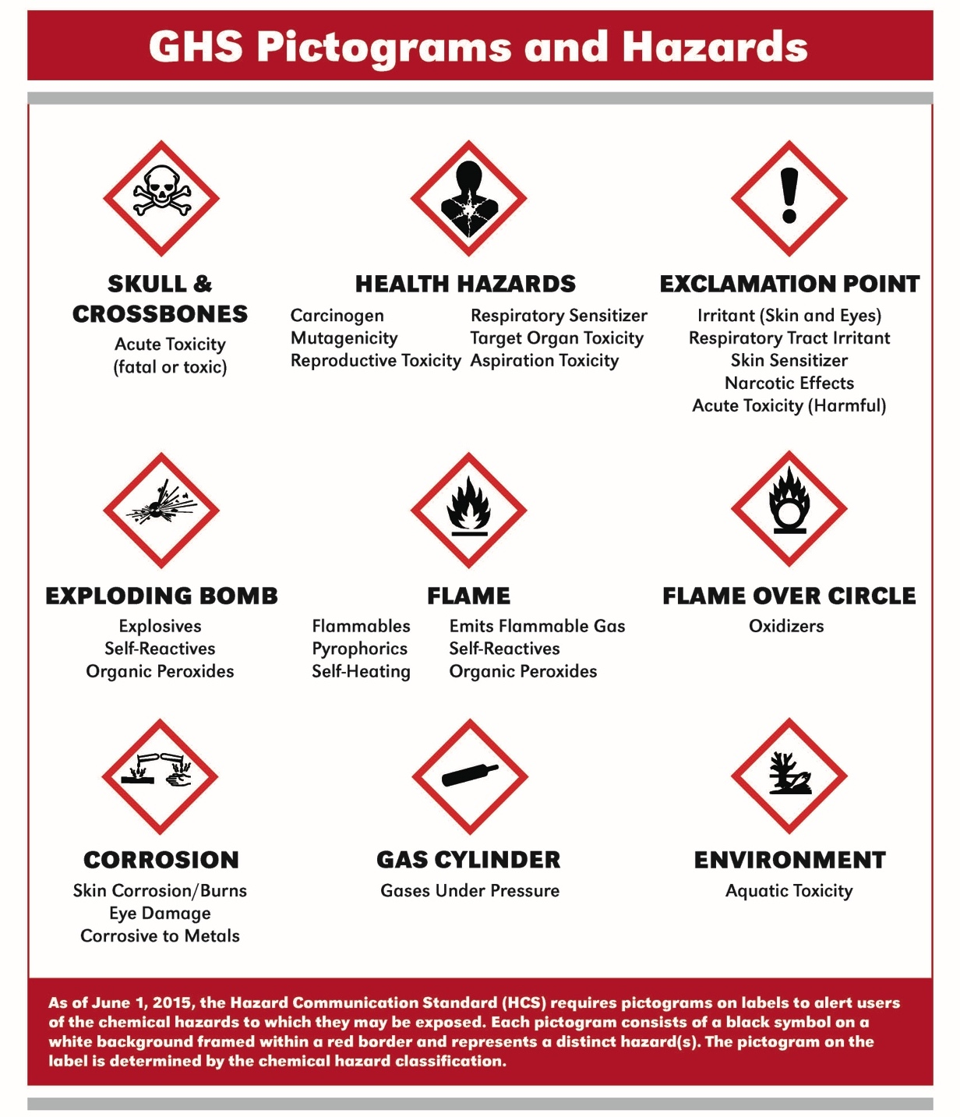
GHS (Globally Harmonized System) for Chemical Hazard Assessment

Slide 7
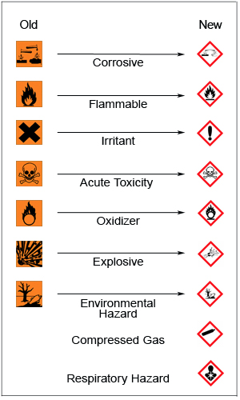
GHS vs. more familiar
Safety Data Sheet warnings:
Acetic acid sounds pretty harmless, right? Try looking up “GHS” or “SDS”?
What about a reagent that you have used or might use?
Any surprises?
www.fireengineering.com

Slide 8
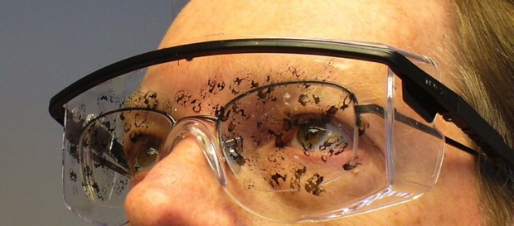
Clothing, Behavior, and Personal Protective Equipment PPE)
Clothing:
  NO open-toed shoes/sandals.
  Approved lab coats required except where specifically exempted (ask if you are not sure).
  Tie back long hair. Avoid loose hair, scarves, neckties, and loose clothing around machinery (e.g., motors, belt drives, lathes)
Eye protection: goggles or safety glasses required unless specifically exempted (ask if you are not sure).
Working alone- Not allowed for new investigators or undergraduate researchers; not encouraged for anyone).
Food/drink: Not allowed in any areas in which reagents are stored/used/dispensed.
Gloves are discussed later.

Slide 9
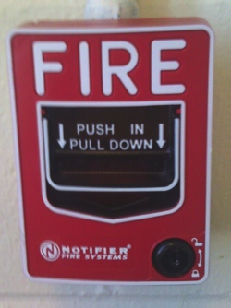

Summoning emergency responders: Fire alarm
North
Hamilton Hall
Fire (unless very minor)
Major chemical spill or toxic leak.
Only easy way to evacuate building
Pull down alarm.
Leave building
Call 472-2222 from outside to give more details

Slide 10
Fire alarm: what should you do?
Exit immediately via stairs. A fire can quickly trap you.
  Turn off the power to equipment (solvent stills, heating mantles, vacuum pumps etc.), only if you can do so without delaying your departure for more than a few seconds. If you later realize that an unattended laboratory operation may pose a hazard, inform a UNL police officer or a member of the safety committee.
  Close and lock office and lab doors behind you.
  Gather to south of Hamilton (Sheldon museum parking lot).
    If your lab is missing someone who was near the fire/emergency, notify emergency officials.
DO NOT reenter the building until the “all clear” signal is given.

Slide 11
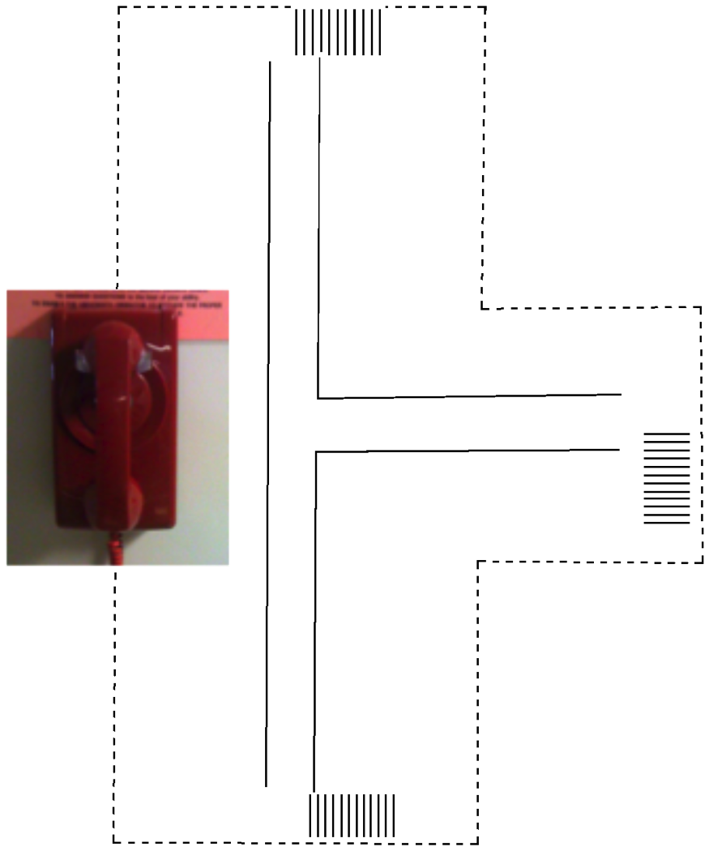
Summoning emergency responders: Red phone or 402-472-2222 or 911
Chemical spill, injury, crime, or a threatening person (anytime you feel danger or see danger to others.
Pick up phone-wait for operator.
Tell him/her:
the type of emergency
the location (Hamilton Hall, what floor, what room)
your name
any other important facts.
  Stay on the line unless you are in danger.

Slide 12
TORNADO alarm
  Seek shelter if you hear the city alarm or if authorities broadcast a tornado warning.
    Tornado alarms are tested at 10:15 am one Wed each month in spring and summer - when the weather is good. If the tornado alarm sounds at exactly 10:15 on a Wednesday, check your phone or computer to see if you need to evacuate.
  Use North or East stairs to get to floors 2,3,4 (north end of corridor) or use elevator to get to basement.
  STAY AWAY from windows. A tornado is likely to shatter windows and create flying glass shards
  DO NOT go outside.
    More information: http://emergency.unl.edu/procedure/tornado

Slide 13
Power outages
Daytime: call business manager (Dodie Eveleth, 2-5312);
After hours: 2-2222 (402-472-2222)
If a power outage lasts more than a few minutes:
  Turn off equipment if there could be problems when power is restored.
  Close hood sashes.
  Lock all doors and leave the building.
  Do not reenter until power is restored.
Major chemical spills (more later)
Pull fire alarm. Use red phone or
402-472-2222 to give information about spill.
DO NOT remain in area of spill unless you are ABSOLUTELY SURE you are not in danger.
If you can safely remain near the spill, use chairs/tables/trash cans to block off area.

Slide 14
Major Injuries:
Call 911 or 402-472-2222 or use Red phones.
Bleeding: Use gloves and safety glasses.
  Apply pressure.
  Yell for help (so someone else can summon ambulance).
Nearest hospital: Bryan LGH West, 16th & South Streets) 402-475-1011

Slide 15
Chemical exposure accidents
Chemical splashes:
  Arm or hand: Blot any material off the skin with clean clothe, paper towel or tissue. Try not to spread contaminated area. Wash in a sink with lots of water as quickly as possible.
  In eyes (wear goggles!)-use eyewash with lots of water.
  Remove contaminated clothing! Blot any residual material off with clean clothe, paper towel or tissue, and get under the shower ASAP!
  Once you have removed the chemical, seek medical treatment. Ask others to bring an MSDS for the chemical. These can be found at:
  HF burns need special treatment. Do not use HF without special training (contact Safety Committee) and access to special first aid supplies

Slide 16
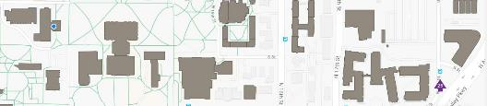
First Aid-minor injuries
Every lab should have a first aid kit
  Students with minor injuries may may go to the Univ. Health Center (Near Beadle): 402-472-5000. Mon-Fri, 8-5.
After hours: A Health Center nurse can be reached by phone:
402-219-8050
  Urgent Care Clinics (non emergency injuries).
  Many- two examples given
  -LinCare, 5000 N 26th St (402-435-2060)
  -Heartland Urgent Care, 965 S. 27th Street, Suite D, 402-477-3505
  More info about injuries:
  http://ehs.unl.edu/sop/s-injury.pdf
  http://www.chem.unl.edu/safety/UNL_Chemistry_Injury_Procedures2013.pdf

Slide 17
Personal Protective Equipment (PPE). 1 of 2
Required for work with chemicals:
  Splash goggles or safety glasses
    Use goggles or a face mask when working with splash hazards (particularly corrosive agents or toxic materials)
    Additional protection may be required for work with lasers or high-intensity UV. Check with your advisor & EHS (SOPs).
  Lab coats
    Fire-resistant cotton (default) or Nomex (specialized, for use of large volumes of pyrophoric reagents).
    Coats can be kept on while moving between labs but should not otherwise be worn outside lab.
    Coats supplied to you; swap out when soiled.
  Shoes with continuous tops (no sandals or open toes!)
  Recommended: long pants

Slide 18
PPE, part 2: Gloves
Disposable nitrile gloves are often used for transient protection:
  Check the permeability of your gloves against the chemical: http://ehs.unl.edu/documents/chemical-safety
  Immediately replace damaged / contaminated gloves. Grasp the sleeve and pull it towards your fingertips, inside-out. Wash your hands before re-gloving.
Work which will involve handling particularly hazardous materials.
  Talk carefully with your lab director and/or EHS about any applications that require prolonged exposure or immersion – you may need thicker gloves and compatibility will become critical.

Slide 19
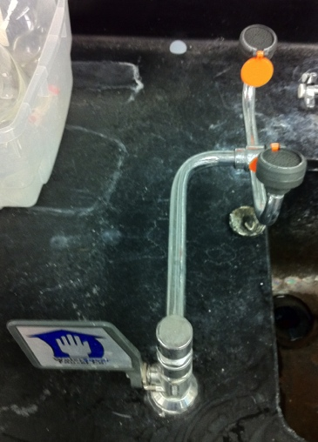
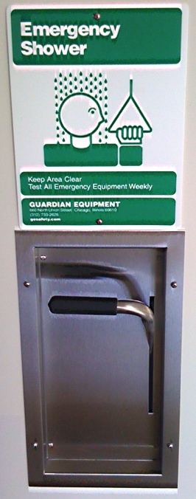
Showers and eyewashes
Showers
  Located just outside or just inside selected doorways
    Where is the nearest one?
  To operate, stand under the shower, and pull down the handle (overhead rings in some parts of building)
Eyewash fountains
  Where is the one closest to you?
    Push on the handle, flush eyes thoroughly (15 min!) Rinse out fountains weekly. Make sure they remain accessible.
•Help the injured person get to the eyewash or shower-don’t worry about the mess
•Yell for help
•Offer your lab coat if someone needs to remove their clothes.

Slide 20
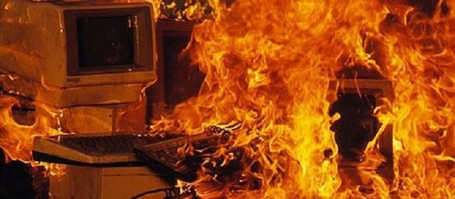
Fires: Fight or leave?
http://flavioontivero.weebly.com/uploads/4/5/3/2/45324599/484178135.jpg
You can fight a fire if:
  It is confined to a small area and you are not alone.
    You need someone as a back-up who can call for help.
  You are in no danger
    You know what is burning and you are either protected from fumes or you are sure there is no danger.
  You have a clear escape path.
    Labs, lab books, chemicals and equipment can be replaced-you cannot.
Do not attempt to fight a fire that is:
  Large or could quickly become large;
  Is making the air hard to breathe (smoke inhalation)
  May expose you to hazardous materials

Slide 21
Fire: Sounding the alarm
For anything more than a very small fire:
  alert your coworkers (yell!):
  close the doors to the area and leave;
  pull the the nearest fire alarm (near each stairwell)
  If you can’t safely get to an alarm on your floor, wait and call 402-472-2222 or 911 from outside.
Once you exit the building
  Call 402-472-2222 or 911 and give the operator more information about the location of the fire.
  When firefighters respond, identify yourself and offer to provide information about the location of the fire.

Slide 22
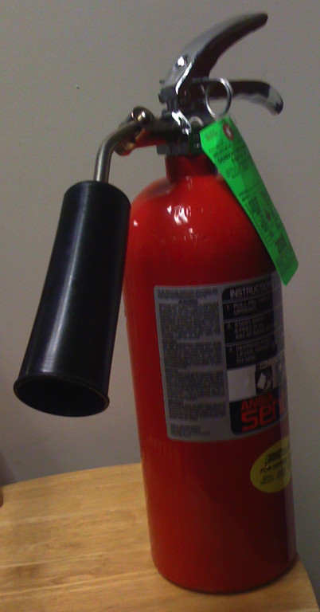
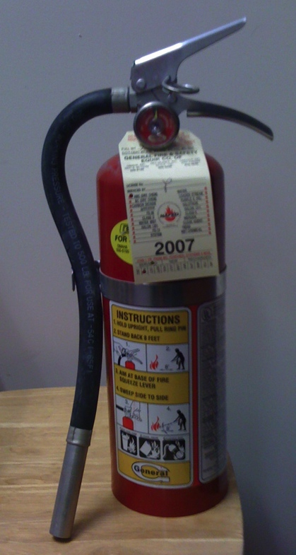
Fire Extinguishers in Hamilton
Dry powder aka
“dry chemical”
Carbon dioxide
  Found in most labs and in multiple locations in hallways.
  Distinguish by large cone or “horn” nozzle on CO₂.
  Choice will depend on nature of fire (next page)
PIN
(release)
To use: (either type)
1. Twist and break plastic retaining strap;
2. Pull out pin;
3. Point nozzle at base of fire;
4. Squeeze handles together to operate

Slide 23
Which extinguisher should I use?
Carbon dioxide:
  Excellent all purpose fire extinguisher;
  Can be used for small solvent or paper fires.
  Must be used for fires around electronics;
Dry powder:
  Will “knock down” most solvent and chemical fires
  Use when CO₂ would react with the burning material (e.g., sodium).
  Never use on people.
  After using a dry powder extinguisher, turn off computers and electrical equipment to minimize damage.

Slide 24
Fume Hoods
Toxic, flammable, or corrosive materials must be handled in a fume hood.
  Do not allow gloves, paper towels, plastic, or foil to be sucked into the back of the hood.
  Minimize use for storage. Place bulky equipment towards the rear of the hood and allow ≥ 2” beneath for air flow.
  Work as far inside the hood as possible and try to minimize the amount the sash is open.
  If a hood does not appear to be working well or if alarm is sounding, contact 2-1550 or the building manager.
  Do not use perchloric acid or radioisotopes without permission from EHS.
  EHS SOP Laboratory Hood/Cabinet Identification & Use, http://ehs.unl.edu/sop/s-lab_hood_use.pdf

Slide 25
Chemicals: What is a hazardous material?
Answer: anything that is flammable, corrosive, reactive, strongly oxidizing, toxic/carcinogenic…. or breaks down to give species with any of the above categories.
Think of some common examples:
  Flammability:
  Corrosive?
  Toxicity?
  Releases flammable or toxic gases upon heating?
The concept of a hazardous material will be very important for transport/use/storage/disposal!
Notes:
Flamm: acetone THF, methanol, etc.
Corrosive: 1N HNO3; conc sulfuric; Br2
Toxicity: dimethyl sulfate, methyl iodide, chloroform
Releases flammable or toxic gas? Metal hydride?

Slide 26
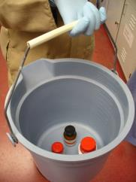
Chemical Transport
Transport of any hazardous materials outside of your lab requires secondary containment, which can be either a specialized container or a sturdy plastic pail. Would you want to be on the elevator when someone dropped a bottle of solvent?
  Shipping crate (for example, transporting from stockroom) “counts” as a secondary container.

Slide 27
Chemical Storage: the quick version
Flammable solvents
  Large quantities in safety containers or in safety cabinets.
Segregate by hazard:
  Oxidizers: Separate from flammables, reducing agents
  Water Reactive: Protect from water, segregate from flammables and oxidizers.
  Inorganic Acids: Segregate from organic acids, flammables.
  Toxics: (includes carcinogens). Segregate, protect from cross-reactions. Would you want to be in a lab where sodium cyanide and sulfuric acid were stored together?
  Segregation can be based upon secondary containers (tubs) For more details, ask a Safety Committee member or see the EHS SOP: http://ehs.unl.edu/sop

Slide 28


Peroxide formation
Some reagents may form shock-sensitive and explosive peroxides upon prolonged exposure to oxygen or air.
  The peroxides may explode or decompose violently upon concentration, heating or friction. Our most serious accident in the past 25 years involved peroxides.
  Diethyl ether (“ether”) tetrahydrofuran (THF), 1,4-dioxane, and cumene are notorious but other chemicals (isopropanol, potassium) can also be a problem.
  Reagents or solvents which may form peroxides (e.g. THF) must be dated upon opening. Once opened, containers must be tested (“peroxide test strips) every 180 days or else discarded.
  See “Use and Storage of Peroxide-Forming Chemicals” (http://ehs.unl.edu/sop) or ask a Safety Committee member for more info.

Slide 29
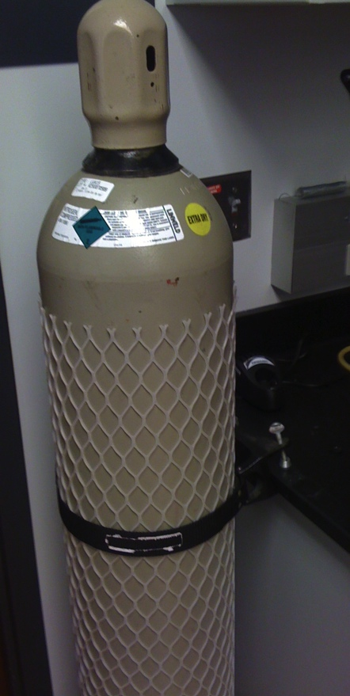
Chemicals: Gas Cylinders
Can have > 100 atm of pressure! If the regulator is snapped off, the cylinder can become a rocket.* A protective cap is required for storage or transport.
Gas cylinders need to be secured in the lab with a strap or chain.
Cylinders must be transported using a cart and must be secured with a strap or chain.
*great video on this: http://mythresults.com/episode63

Slide 30
  Chemical labeling: Requirements vary with container and usage: http://ehs.unl.edu/sop/s-chemlabelguideline.pdf
  Commercial containers
    Must have full name, CAS #, hazard pictograms, etc.). Original label must not be removed or altered.
  Durable containers (more detail next page)
    You prepare; kept > 1 session and/or used in a common area.
  Transient Containers (more detail following pages)
    < 1 session; always in your personal control.
  Waste (aka “used”, “spent”, “recovered” containers). Strict labeling requirements!
  Unknowns: Samples that lack adequate labeling

Slide 31
Durable containers
Containers you have filled/prepared. Contents will be used for more than one work session and/or will be at times outside of your personal control. Common examples: stock solutions or custom-prepared reagent (unless disposed of or consumed in one work session).
Minimal labeling required: product identifier/chemical name (concentration recommended, not required).
  Can use an acronym or abbreviation if a cross-reference is posted in the work area.
  Avoid use of empty food containers.
  Avoid labels that will smear or fade (printed labels much better than marker).
  Small containers, such as vials and test tubes, can be labeled as a group (label the outer container or rack).

Slide 32
Transient containers
… used to hold chemicals for less than one work shift and that will remain under your complete control.
  No labeling is required for these containers if they remain completely under your control for less than one work session). Examples include solutions that will be used immediately in an experiment and cleaning solutions that will be discarded by the end of a shift.
  However, an unattended transient container or one used in an unsecured area, immediately becomes a “durable” container and must be labeled.
  Transient containers that are forgotten can become “unknowns” or “waste” containers, which raises huge problems.

Slide 33
Unknown chemicals
Major problem. Legally considered a hazardous material until proven otherwise.
  Discovery of an unknown chemical that proves to be a hazardous material can result in fines of $25,000/sample for each day of violation.
  Label everything.
  If you have 144 nearly identical samples in a rack, you can legally label the rack.
If you discover unknown materials:
  Attempt to identify them using your own knowledge and records; ask your advisor/supervisor.
  Ask the Safety Committee for help.

Slide 34
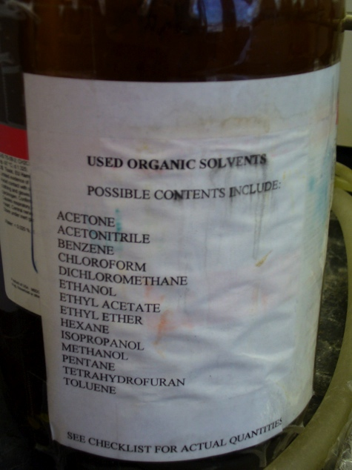
Chemical disposal (“waste”)
Much stricter labeling/container rules:
  Must use full names (no abbreviations or formulas)
  Must show all significant constituents.
  “Used”, “spent”, “waste” all considered appropriate.
  Must be stored in compatible container.
  Repurified materials (e.g. redistilled solvents) can be treated like reagents (see previous pages).

Slide 35
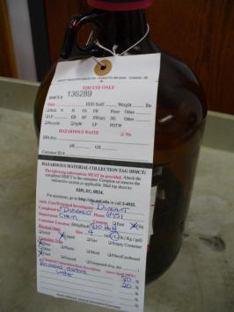
Chemical disposal: via EHS (402-472-4925)
Containers
  Closed, compatible, in good condition.
  Store consistent with contents (e.g., flammable waste in a flammable storage cabinet)
  Label with full names
  Tag for disposal (example at right) http://ehs.unl.edu/sop/s-chem_collection_procedures.pdf
Can it go in the drain or trash?
  http://ehs.unl.edu/sop/s-sewerdisp.pdf
  http://ehs.unl.edu/sop/s-dumpster_ban.pdf
  If you are unsure, contact EHS
Waste bottle with disposal tag

Slide 36
Chemical Spills: “Should I stay or should I go?”
  Tailor your response to the hazard and situation
You must know the material (and the hazards)
  Do you have appropriate PPE?
  Are you sure you will be safe (ventilation, etc.)?
  Do you have someone with you as back-up?
If a spill is large or dangerous, leave!
  402-472-2222, 911 or red phone from a safe distance.
You may attempt to deal with chemical spills if:
  You are in no danger, you are not alone and you have a path of retreat.
  You have appropriate PPE and a spill kit.
See: Preplanning for and Responding to Hazardous Chemical Spills
at http://ehs.unl.edu/sop

Slide 37
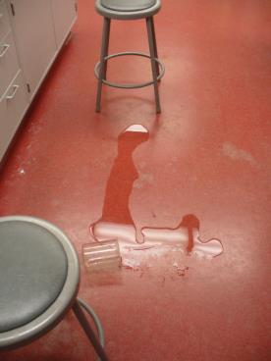
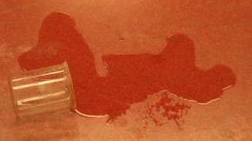
Chemical spills: what should you do?
For any spill, first priority is to alert others (fire alarm, red phone, 402-472-2222)
  Close off the area if this is safe for you.
  Use chairs/stools to close off part of a lab or corridor for a smaller spill
  Use the fire alarm to clear the building in case of a major spill.

Slide 38
Dangers of a chemical spill/release
“An investigation by OSHA determined that one worker was overcome when “methyl mercaptan gas (aka methanethiol) was unexpectedly released” after she opened a drain on a vent line. Two coworkers nearby, unaware of the leak, attempted to save her but were also consumed (killed) by the gas. The brother of one of the victims rushed to rescue the three but was also overcome (killed) by the gas.”
One spill/release, four deaths.
Chem. & Eng. News. May 25, 2015

Slide 39
Chemical spills: clean-up kits
Your lab needs spill kit(s) appropriate to the nature of chemicals you store and use. All spill kits should contain:
  Vinyl and nitrile gloves, large (1 pr each); safety goggles (2 pairs); plastic shoe protectors (2 pairs); dustpan (1); polyethylene trash bags (≥10). Adsorbent pads/pillows are also a good idea.
Labs working with solvents should also have:
  5 gallon bucket of sorbent or “kitty litter” (labeled)
Labs working with acids:
  5 gallon bucket of Na₂CO₃ or NaHCO₃ or similar.
Labs using Hg should have a commercial spill kit.
Kits must be labeled and readily accessible. All lab workers need to know of the kits and their location.
See “Preplanning for and Responding to Hazardous Chemical Spills” at http://ehs.unl.edu/sop.

Slide 40
Chemical spills: “bare-bones” procedures
Acids
  Confine, neutralize (bicarbonate), clean up, dispose (call EHS).
Flammable solvent
  Eliminate ignition sources, confine, absorb, clean up, dispose (call EHS).
Mercury
  Consolidate, collect, dispose of, wash yourself.
  Always call EHS (2-4925) for consult
Solids
  Scoop, place in container for disposal by EHS.
See http://ehs.unl.edu/sop/s preplan_respond_spills.pdf

Slide 41

Radiation Safety
Radioactive materials use = special protocols
PI/facility must have authorization (annual renewal!)
  Limited to use in approved lab spaces /hoods
Requires separate training (http://ehs.unl.edu/#RadSafety)
Requires active monitoring (badges/dosimeters)
Has separate requirements for storage; use; spills; waste aggregation; waste disposal
More information
  EHS Safe Operating Procedures
    http://ehs.unl.edu/sop/radiation-safety
  Joel Webb, UNL Radiation Safety Officer
    (402) 472-2157 jwebb2@unl.edu

Slide 42
Biosafety (1 of 2)
Protocols involving live organisms, their genetic precursors, or selected toxins require different safety measures and different training:
PI must have authorization to work with organisms (Procedures/protocols often require approval by Institutional Biosafety Committee (IBC).
  Talk to your advisor or the UNL Biosafety Officer (next page) before bringing a new organism/DNA/toxin onto UNL. Select agents are a particular concern: http://ehs.unl.edu/sop/SA_SOP_SelectAgents.pdf
  Research space and your training must be appropriate for the hazard Biosafety Level (BSL): http://ehs.unl.edu/sop/s-bio-training.pdf.
  Biosafety protocols will apply in departmental culture and cold rooms.
  Many/most materials may require documented sterilization prior to disposal.

Slide 43
Biosafety (2 of 2)
Biosafety-resources:
  Chemistry: Biofacilities Users Group Committee (cold rooms, incubator, culture room).
  Chair: Prof. Jiantao Guo:402) 472-3525 jguo4@unl.edu
  EHS Safe Operating Procedures re Biosafetyhttp://ehs.unl.edu/sop/biosafety
  EHS Biosafety Officer
  Dr. Matthew Anderson, Biosafety Officer
  (402) 472-9554 manderson11@unl.edu

Slide 44
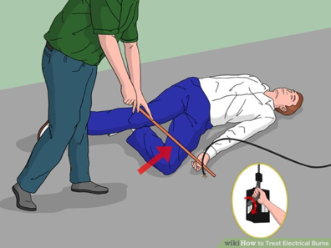

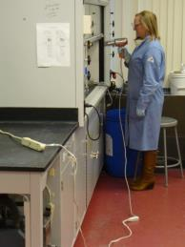
Electrical hazards
Always look first
  Do not work on electrical equipment or touch an unconscious person unless you are sure there is no source of electricity.
Avoid spark sources near solvents
Electrical cords/ cables
  Should not obstruct work or aisles.
  Extension (“drop”) cords only for short-term use; power strips can be used long-term but not on high amperage devices.
  Do not “daisy-chain” cords or power strips.
  Discard and replace damaged cords.
Consult Chemistry Electronics shop with any concerns.
science.howstuffworks.com
Localelectricalne.com

Slide 45
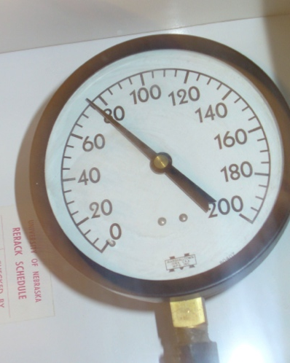
Floods
Costly and usually avoidable. Our most common accident/incident, (and the one that will make you very unpopular).
The water pressure in Hamilton can be quite high. Unsecured hoses can easily slip off of fittings or out of drains.
Pressure on 8th floor nearly 80 psi
(pounds/square inch) or 5.5 bar. Presumably greater pressures on lower floors

Slide 46
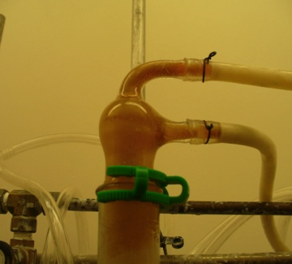
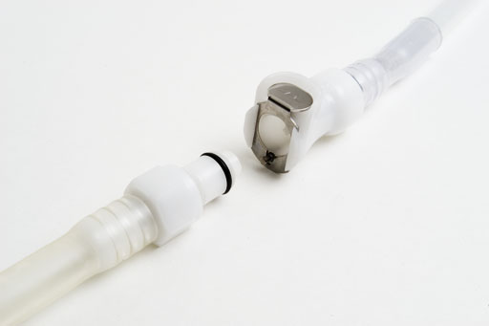

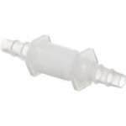
Flood prevention: Easy steps
Minimize unattended water use.
Clamp hoses onto fittings (clamps best, wire OK).
Leak-proof “Quick connect” hose connections now available.
Not to be used
for any unattended operations
Secure drain lines (length of hose down drain; by clamping or anchoring hose)

Slide 47
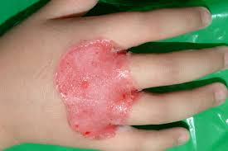
Cryogens
Liq. N₂ (boils at -196 °C)
  use only with good ventilation; be careful about condensing O2
Dry ice/acetone slushes are not as cold (-80 °C) but have high heat capacity and “stick”. Frostbite can result in seconds. Rinse skin under cool water.
PPE: Heavy leather gloves and lab coat for short term use of cryogens. If the gloves or coat get "soaked" in a cryogen, quickly take them off and move away from the hazard!
Questions?
See ehs.unl.edu/sop/s-cryogenic_material.pdf‎ or contact Prof. Martha Morton
Frostbite from use of a cryogen during skin treatment anagen.ucdavis.edu

Slide 48
Personal Safety and Crime.
UNL is fairly safe (see http://police.unl.edu/statistics) -let’s keep it that way.
  Don’t prop open outside doors or admit strangers.
  Be careful when you are alone. Use a “buddy” system.
  Lock valuables in desk drawers when leaving offices.
  See something suspicious? 402-472-2222
    http://police.unl.edu/reporting-troubling-or-threatening-behavior)
If you feel you are in danger, remember:
    Run - If there is a clear and safe escape route
    Hide - If there is no escape and you can get to a secure location to hide
    Fight - If your only option is to defend yourself, fight as if your life depended upon it.
    https://emergency.unl.edu/procedure/shooting-incident

Slide 49
Safety Committee (2019-2020)
Jiantao Guo, co-Chair
  634A HaH; jguo4@unl.edu
  2-3525 (office)
Martha Morton, co-Chair
  834 Hamilton, 2-6255; mmorton4@unl.edu (860)428-2044 (cell)
Mark Helle, Chemical and Laboratory Safety Specialist
  403 HaH, 2-2649, mhelle2@unl.edu
Members
  Prof. Barry Cheung (514 HaH, 2-5172)
  Ms. Dodie Eveleth (Building manager, 545 HaH, 2-5312)
  Prof. Rick Hartung (326 HaH, 2-2737)
  Ms. Jessica Periago (227 B HaH, 2-3812)
  Prof. Alex Sinitskii (604C HaH, 2-3543)
  Ahaileas Harisis (EHS, 2-5773)

Slide 50
Links and Resources
UNL Chemistry: http://www.chem.unl.edu/safety/
UNL Environmental Health and Safety:
  Online training: http://ehs.unl.edu/onlinetraining
  Safe Operating Procedures (many!) http://ehs.unl.edu/sop. Examples of available SOPs: Chemical Safety (more than a dozen); Waste Management; Accidents and Injuries; Biosafety; Emergency Preparedness; Laboratory SOPs; Laser Safety, etc…….
  As a general resource: Questions about chemical safety, reaction hazard assessment, labeling, disposal-almost anything?
  http://ehs.unl.edu/ (402-472-4925)

Slide 51
Things to do TODAY
Put the UNL Emergency contact on your phone:
  402-472-2222
Sign up for UNL Emergency Alerts:http://unlalert.unl.edu
Thank you for attending. Contact me if you have any questions or concerns:
  Prof. Martha Morton
  (402)-472-6255
  mmorton4@unl.edu

